Slide 1
Minimize Risk in Credit Card Transactions
Presented By:
David Musili
Griffin Roberts
Michael Lima
March 4th, 2024

Slide 2

Agenda
01. About Us
02. Our Clients
Provide an overview of our company
Discuss the solutions that we provide
03. Our Solutions
04. Model Demo
05. Data Analysis
06. Conclusion
TBD
TBD
.
TBD
TBD
February 29, 2024

Slide 3
1. About Us
DataInsight Solutions is a dynamic startup at the forefront of harnessing the power of data science to drive innovation and informed decision-making.
Founded by a team of experienced data scientists and industry experts, we offer cutting-edge solutions to unlock the full potential of data for businesses across various sectors.
From predictive analytics to machine learning and AI-driven insights, we empower our clients to extract actionable intelligence from their data, enabling them to stay ahead in today's rapidly evolving digital landscape.
Our commitment to excellence, coupled with a passion for solving complex challenges, sets us apart as the trusted partner for organizations seeking to leverage data as a strategic asset. At DataInsight Solutions, we turn data into value, transforming businesses and shaping the future of industries.
February 29, 2024

Slide 4





2. Our Clients
February 29, 2024

Slide 5

2. The Problem
Presenter: Michael Lima

Slide 6
Problem Statement
The challenge is to recognize fraudulent credit card transactions so that the customers of credit card companies are not charged for items that they did not purchase. Main challenges involved in credit card fraud detection are:
Enormous Data is processed every day and the model build must be fast enough to respond to the scam in time.
Imbalanced Data i.e. most of the transactions (99.8%) are not fraudulent which makes it really hard for detecting the fraudulent ones
Data availability as the data is mostly private.
Misclassified Data can be another major issue, as not every fraudulent transaction is caught and reported.

Slide 7
Data Insight’s Approach
Data Insight’s solution has created simple and fast enough model to detect the anomaly and classify it as a fraudulent transaction as quickly as possible.
Imbalance is dealt with by properly using appropriate methods.
For protecting the privacy of the user the dimensionality is reduced.
4. The model is simple and interpretable so that when the scammer adapts to it with just some tweaks we can have a new model up and running to deploy.

Slide 8

3. DataInsight’s Solution
Presenter: Griffin Roberts

Slide 9

Source Files
1. creditcard.csv
Credit Card data
Acknowledgements
The csv files noted above were downloaded from Kaggle.

Slide 10
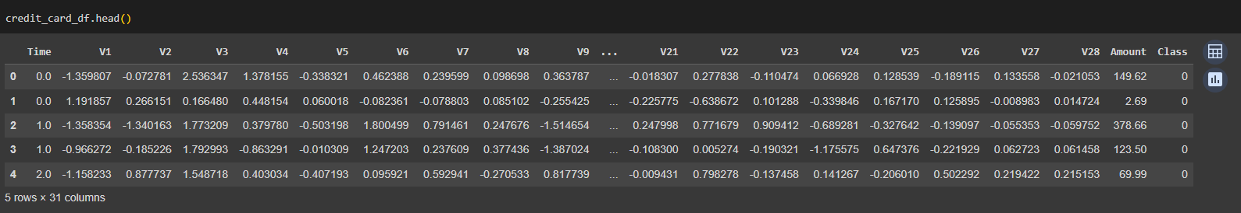
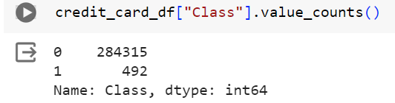
Data Exploration Process
How did we explore the data?
The data was already anonymized
The data had more valid transactions than fraud transactions

Slide 11
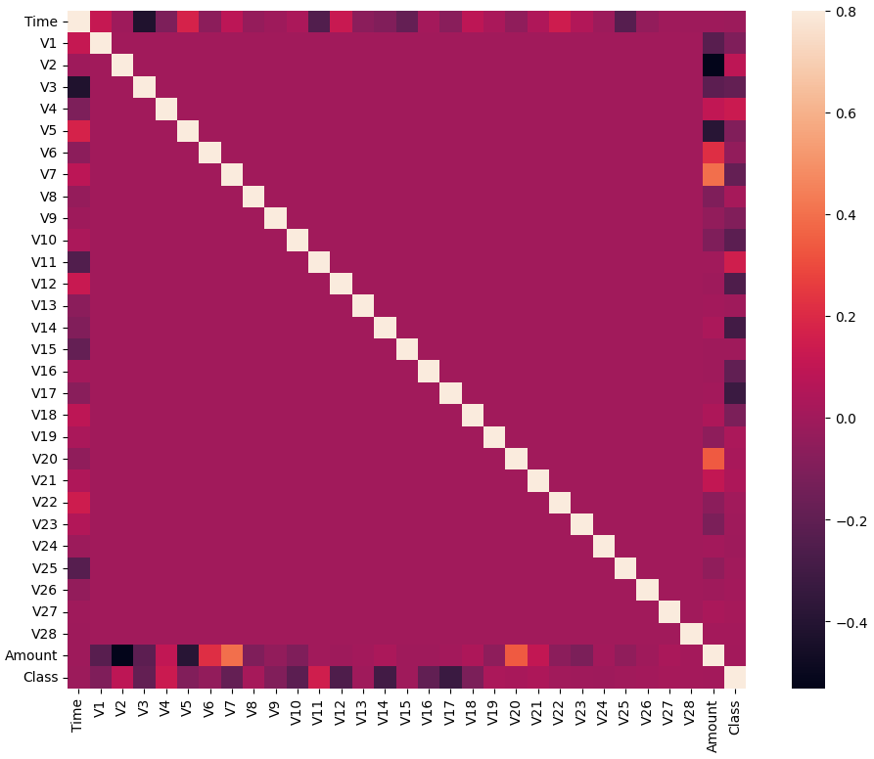
Data Exploration Process (contnd)
How did we explore the data?
3. There is minimal correlation

Slide 12
Data Preprocessing
How we cleaned up the data
We dropped the time from the X data and separated the target
We split the training and test data
We scaled the data MinMaxScaler
Used oversampled data on the training data

Slide 13

Model Perfomance

Slide 14
Models
Model | Training Score | Test Score | Recall (fraudulent) | F1 (non Fraudulent) | F1 Macro Average
Decision Tree Classifier | 1.0 | 0.99919 | 0.76 | 1.00 | 0.87
Random Forest | 0.94510 | 0.93878 | 0.89 | 0.94 | 0.94
K-Nearest Neighbor
Support Vector Classifier | 0.9609 | 0.9490 | 0.92 | 0.95 | 0.95
XG Boost | 1.0 | 0.99950 | 0.78 | 1.00 | 0.91
ADA Boost Classifier | 0.9993 | 0.9993 | 0.93 | 0.98 | 0.52
Logistic Regression | 0.9991 | 0.999 | 0.86 | 1.00 | 0.77
Gradient Boosting Classifier | 0.9992 | 0.9989 | 0.93 | 0.98 | 0.52

Slide 15
Top Performing Models
Based on our analysis, we determined that the top 3 models are
Support Vector Classifier
ADA Boost Classifier
Gradient Boosting Classifier
The primary determining factors were
High Recall i.e. the ability for the model to detect fraud
There was a low difference between training and test data scores.
The High F1 scores show that there balance between fraud detection and reducing false positives

Slide 16
Pros and Cons of the Top Models
Support Vector Classifier
Pros
Low risk of overfitting
Effective recall
Cons
Hard to interpret model’s logic
Retraining model takes a long time
ADA Boost Classifier
Pros
Exhibits strong performance metrics with high precision and recall, particularly important for detecting fraudulent transactions
Consistent training and testing scores suggest good generalization without overfitting.
Cons
Gradient Boosting Classifier
Pros
Cons

Slide 17
Pros and Cons of the Top Models
Support Vector Classifier
Pros
Low risk of overfitting
Effective recall
Cons
Hard to interpret model’s logic
Retraining model takes a long time
ADA Boost Classifier
Pros
Strong performance metrics
Low risk of overfitting.
Cons
Potential performance imbalance
Sensitive to noisy data and outliers
Gradient Boosting Classifier
Pros
Good recall for fraud
Reduces risk of misidentifying fraud as non fraudulent
Cons
Low precision on fraudulent transactions
Can be prone to overfitting

Slide 18
Recommendations
We recommend TBD Model.
TBD

Slide 19
References
https://statinfer.com/204-6-8-svm-advantages-disadvantages-applications/
https://www.kaggle.com/datasets/mlg-ulb/creditcardfraud?resource=download

Slide 20

Thank you

